Slide 1
Innovation and Technology Management
OENG1115
Lecture 3

Slide 2
Today’s Session Overview
Time | Activity | Comment
5:30pm | Lecture | Welcome Course Content Innovation and Technology Strategy Intellectual Property Strategy (Dr Hishani Prabaharan, Patent and Trade Mark Attorney)
7:30pm | Tutorial | Activities to cement you understanding Question and Answer Assessment 2 Overview

Slide 3





Lets recall last time..……
Project overviews:
Richard Taube (FORD), Light Vehicle Emissions Project
Marcos Anastassiou (RMIT), Road – Rail Separation Project
Christopher Wong (Dept. of Transport), Rolling Stock Project
Humanistic aspects of managing innovation and technology

Slide 4
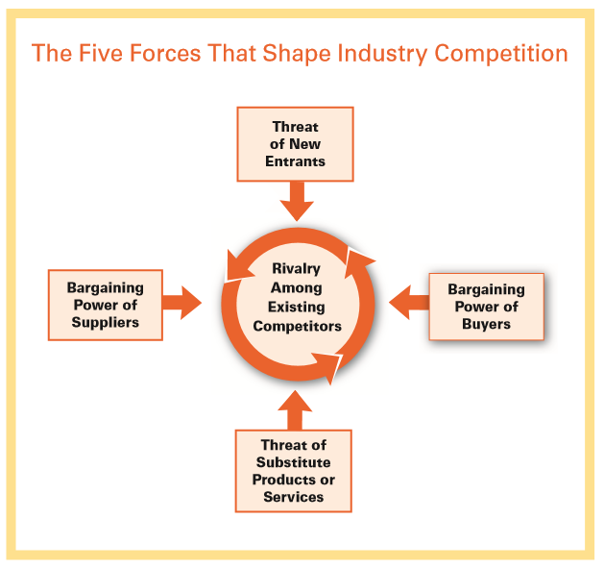
Industry Competition
Businesses develop strategies to build defences against competitive forces or to open up an area where the forces are weakest.
Being innovative and introducing new technologies is one effective strategy to compete and win.
y
Michael E. Porter Harvard Business Review, January 2008, p78

Slide 5



Strategy
You Need A Strategy
To Achieve A Goal
and….Backup Plans
Images Credit
https://www.trekkingteamgroup.com/blog/the-great-himalayan-trail-
Dallas Interchange – Wikipedia, https://en.wikipedia.org/wiki/Interchange_(road)
Notes:
Context. Need to plan ahead. How will this man get to the top of the mountain ?

Slide 6
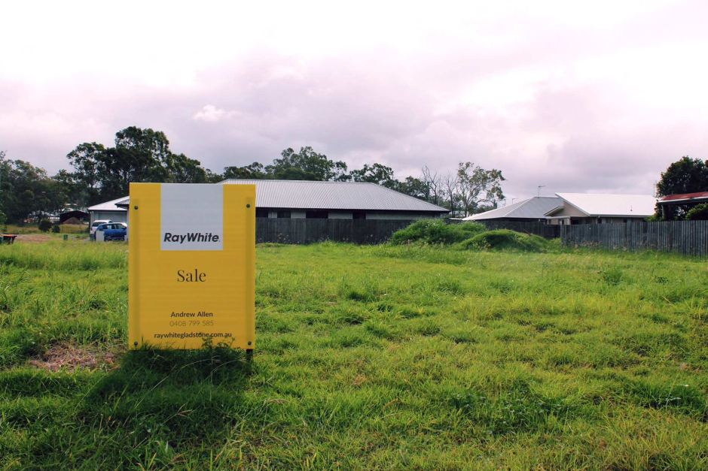



Strategy – Its Essence
Higher level plan summarizing the key elements and actions required to achieve a goal
Where are we now? Your current strategic position and clarify your mission, vision, and values.
Where are we going? Establish your competitive advantage and your vision of the future
How will we get there? Lay out the road to connect where you are now to where you’re going. Strategic objectives, goals, and action items and how you’ll execute your plan.

Slide 7
Innovation and Technology Strategy
A plan to achieve an outcome focusing on how innovation and the application of new or existing technologies can support the business achieving its goals (its competitive position).
More than managing intellectual assets (see future Course modules)
It connects to the overall business strategy and sub-plans thereof such as:
Human resources
Marketing
Sales
Asset management
Capital expenditure
Compliance management: warrantees, standards, codes

Slide 8
INNOVATION / TECHNOLOGY STRATEGY MUST SUPPORT AND SHAPE BUSINESS STRATEGY
BUSINESS STRATEGY
Products/Processes
Service
Competitive Position
Finances
Operations
Human Resources
INNOVATION /
TECHNOLOGY
STRATEGY
COMPETITIVE
ADVANTAGE

Slide 9
Innovation & Technology Strategy
According to Rieck and Dickson: there are six key elements:
Setting horizons
Industry forecasting
Technology positioning
Technology availability
Appropriating technology
On-going management of the technology
Notes:
Important to understand the context of your business, what your goals are and how innovation and technology can assist – interrelated into other business plans.
What are the industry drivers and trends that will influence your business?
If your business needs to adapt or change how will you go about this?
What (technology) is missing, how can you get it and manage its introduction and continual improvement once implemented.

Slide 10

1. Setting Horizons
Images Credit
https://devpolicy.org/five-trends-for-the-future-of-development20110420/

Slide 11
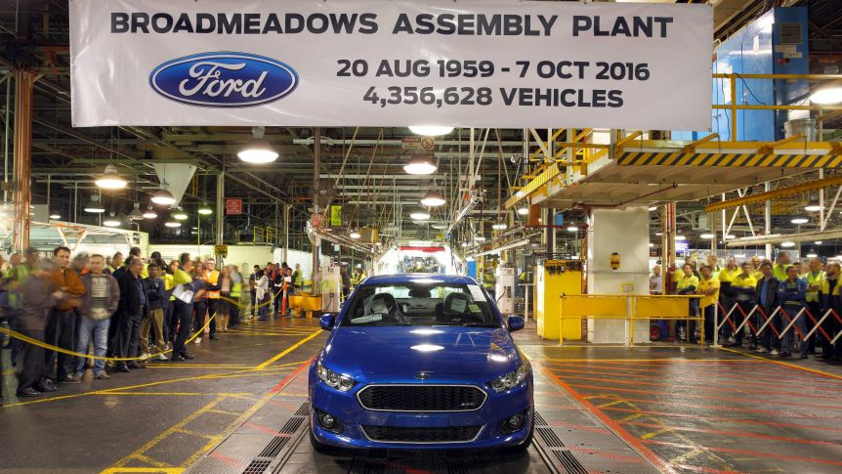
The Future Business
Understanding the future business
What industry sector/s do we want to be active in the future ?
How will we compete?
Example:
Diversification of the Australian automotive supply chain post closure of assembly
Diversification requires:
Innovative culture
Agility
New skills
New technologies
New business models
Capital
Markets
Michael Porter: Competitive Advantage – Creating and Sustaining Superior Performance, The Free Press, 1998
Notes:
See also the work of Michael Porter: Five forces analysis
Porter's five forces analysis is a framework that attempts to analyse the level of competition within an industry and helps business strategy development. A further iteration of SWOT analysis
Five forces:
threat of new entrants,
threat of substitute products/services,
bargaining power of customers,
bargaining power of suppliers
5. intensity of competitors
Michael Porter: Competitive Advantage – Creating and Sustaining Superior Performance, The Free Press, 1998

Slide 12

2. Forecasting

Slide 13
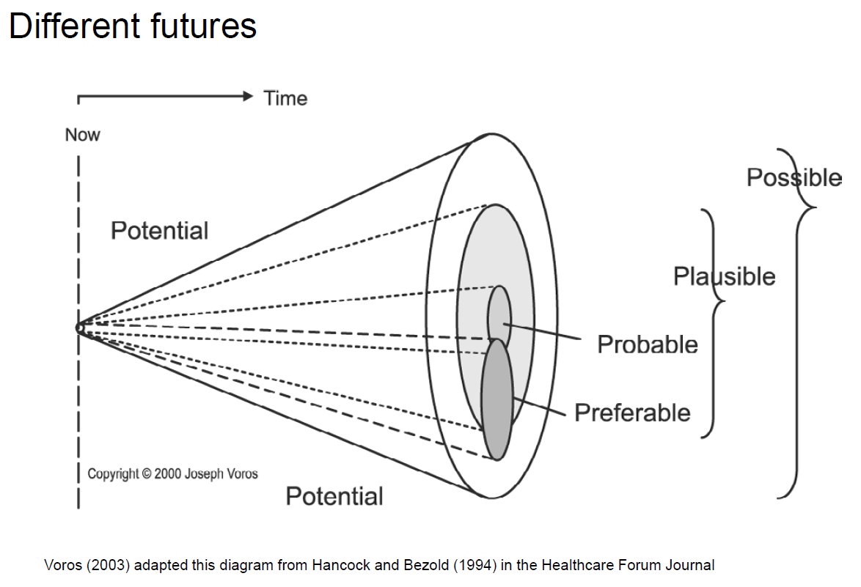
What Can We Predict
Once we know what sort of business we want to be:
What does the future of this industry segment look like?
Need to consider:
The future is not predetermined.
The future is not predictable.
Future outcomes can be influenced by our choices in the present.
Joseph Voros, A generic foresight process framework,
Foresight, (2003), 5 (3), p10-21

Slide 14

Mega Trends
Overall trends that shape our future
Comprised of many trends
Technological
Societal
Environmental
Can be influenced by:
Radical discoveries
Radical events (disease, war etc….)

Slide 15






Mega Trends: CSIRO
1. More from Less
2. Going Going Gone
3. Silk Highway
4. For Ever Young
5. Digital Twin
6. Great Expectations

Slide 16

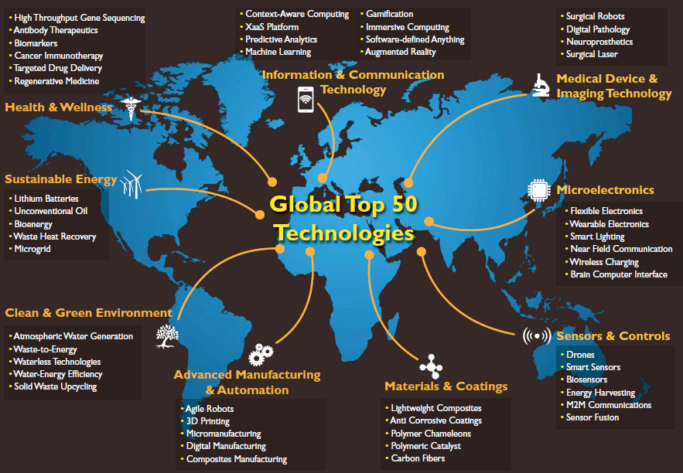
Major Corporations Consider The Future
Frost and Sullivan: TechVision
Notes:
http://www.fujitsu.com/uk/Images/inspiring-innovation-megatrends-infographic.pdf

Slide 17
Imagining The Future of Automotive
https://www.youtube.com/watch?v=VwsusVukikg
Beyond the marketing the clip demonstrates how innovation and technology strategy is focused on delivering benefits across multiple fronts:
Economic
Environmental and
Societal

Slide 18

Government Priorities Influence The Future
Government and government agencies influence/set
Key policies (eg: trade)
Compliance to global accords etc (eg: emissions)
Regulations: safety, environmental etc
Financial settings
Taxation
R&D tax concessions
Recall the carbon tax from 2012
Grants: Start ups, R&D, industry support packages
Government purchasing power (eg Defence contracts)
Uncertain government policy settings can lower confidence, expenditure and entrepreneurship / intrapreneurship.
Organisations often need to think beyond the policy settings of the day
Notes:
See:
http://www.business.gov.au/advice-and-support/IndustryGrowthCentres/Pages/default.aspx
http://www.defence.gov.au/WhitePaper/

Slide 19

3. Technology Positioning
Images Credit

Slide 20
How Will We Compete
How will the technology/innovation be used for advantage ?
Linked to the overall business plan:
Timing is key
Offensive, defensive, reactive, strategic
How close to the technology edge is the company comfortable
Industry dependant
At the cutting edge, close follower, laggard etc etc.
Useful to consider stakeholders appetite for new innovative technologies
Customers
Workers
Management
Consider SWOT analysis & RISK analysis
Notes:
Porter: The Technology Dimension of Competitive Strategy, Research on Technology Innovation, 1, (1983) p1
How the business wants to address the market will influence the technology portfolio and innovation systems it employs
Strategically it might be better to move first to gain an IP advantage or “first into the market” advantage, but that strategy carriers risk.
You may need to negotiate new “standards” for example or convince regulatory bodies that your product is safe .

Slide 21
To Lead or Not To Lead…..
Leading requires resources and time to develop it
How much distance do you want to put between your competition
Type of industry (high tech or low tech)
R&D carries risk
Will market accept the new concept / will you work force embrace change
According to Porter the technological follower takes advantage of
Irreversibility's afflicting the leader by moving first
Potentially lower cost of adapting rather than creating technology change
Entrepreneurial companies (including Startups):
First to market – minimal viable product
Agile and responsive
Porter: The Technology Dimension of Competitive Strategy, Research on Technology Innovation, 1, (1983) p1
Notes:
Porter: The Technology Dimension of Competitive Strategy, Research on Technology Innovation, 1, (1983) p1
How the business wants to address the market will influence the technology portfolio and innovation systems it employs
Strategically it might be better to move first to gain an IP advantage or “first into the market” advantage, but that strategy carriers risk.
You may need to negotiate new “standards” for example or convince regulatory bodies that your product is safe .

Slide 22
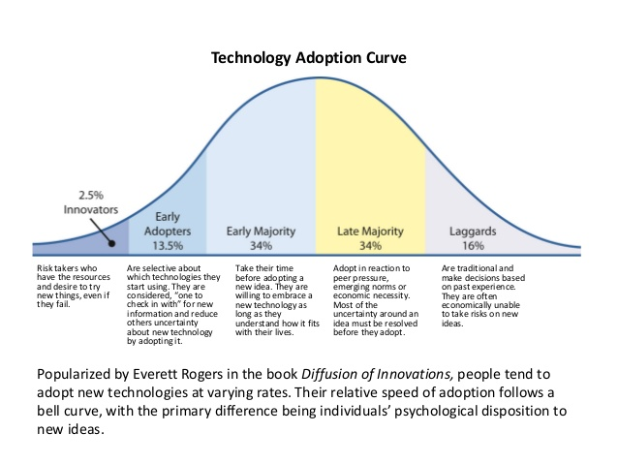
Technology Adoption Curve
For a fun example relating to this see “Dancing Guy”: https://www.youtube.com/watch?v=hO8MwBZl-Vc
https://leif.me/2016/12/on-the-diffusion-of-innovations-how-new-ideas-spread/

Slide 23
Technology Roadmap
Industries utilize technology roadmaps as a mechanism of planning for the future
Provides a strategy to reach company goals
Guides R&D plans or technology/capability acquisitions, identifies key gaps and vulnerabilities
Significant due diligence behind each point on the map

Slide 24
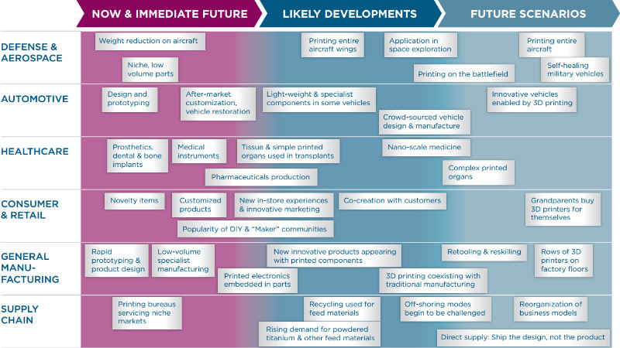
Technology Roadmap – 3D Printing

Slide 25
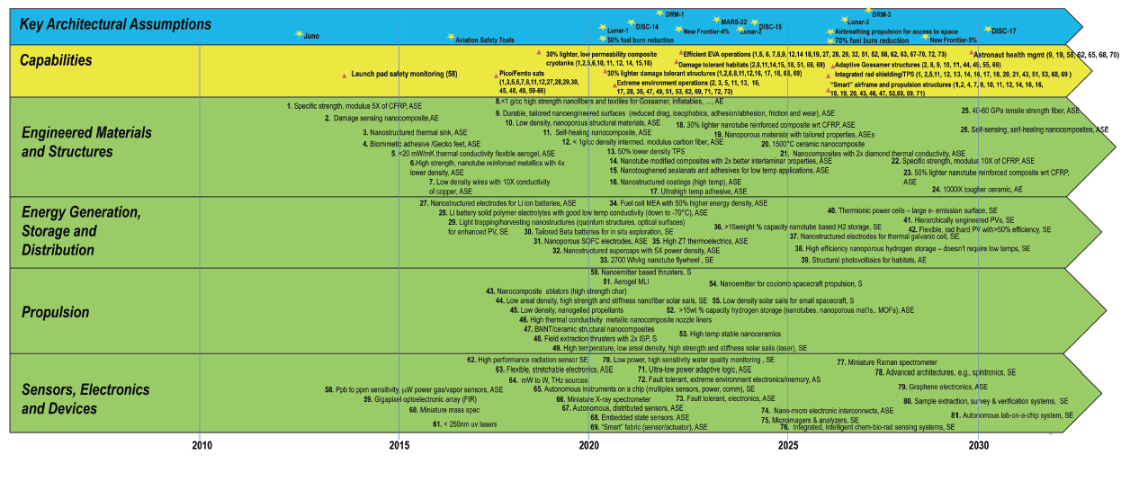
Nanotechnology Roadmap - NASA
Source: NASA Nanotechnology Roadmap

Slide 26

4. Technology Availability

Slide 27
Access To Winning Technologies
Once the firm has identified the technology requirements it must be sourced.
Internally sourced
Develop the technology in house and protect it (patent, design etc)
Conduct Research and Development
Externally source it
Purchase it (or take a license), hire new staff, adapt technologies from other industries, utilize expired patents
Partner: joint venture, collaborative research
Need to complete a technology audit
What do you have and what do you need – understand the gaps
Consider facilities, processes and people to deliver
Safety and environmental impact

Slide 28

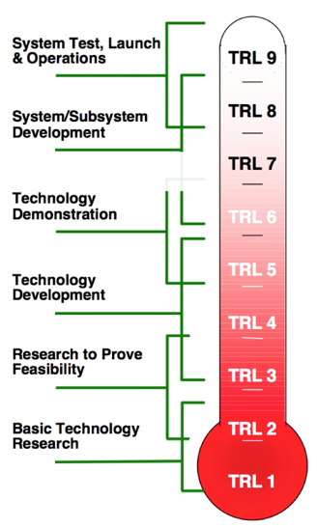
Technology Readiness Level (TRL)
(TRL 10)
proven
Successful full scale operations
production ready
System proven through successful operations
application ready
Ready for full scale production
System completed & qualified through tests + demos
practical
Prototype demonstration in an operational environment
Prototype demonstration in a relevant environment
feasible
Validation in a relevant environment
Component validation in a lab environment
discovered
Proof of concept
Concepts and/or applications formulated
Basic observations made and reported

Slide 29
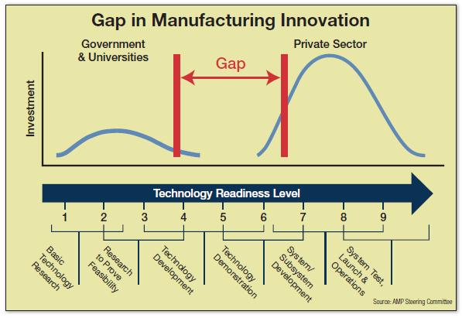
Valley Of Death
Source: Manufacturing Engineering, 2015
http://www.sme.org/MEMagazine/Article.aspx?id=8589934630
Notes:
Interesting innovation debate at present in Australia:
Australia is very good at science and delivering scientific outputs (eg: journals and to some degree patented technologies per capita)
Australian R&D providers including universities are relatively poor at engagement with industry across many sectors. This and for numerous other reasons we do not see our basic science translated into new innovative commercial products, processes etc compared with what one might anticipate.
Eg: lack of venture capital in Australia, risk aversion, a lack of large Australian firms, distance from markets. Are our researchers working on the right things, that industry wants…..does industry know what it wants ……?
Australian government initiatives and debates are seeking to change this, including an investigation over the metrics on how universities are judged.

Slide 30
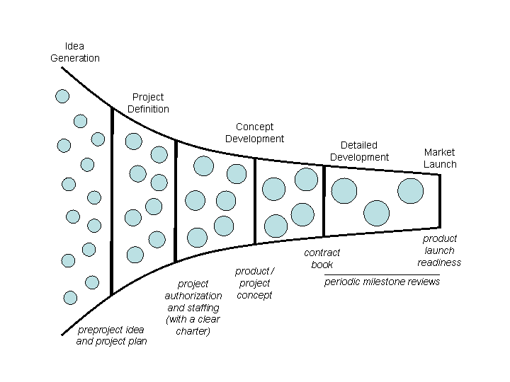
Project Funnel.
Decision Points
Portfolio approach:- spread the risk
What are the Decision point criteria?
What are the questions to kill off ideas?

Slide 31
Heilmeier’s Catechism - Contains 9 questions you should be able to answer (from DARPA (Defence Advanced Research Projects Agency, USA)
What are you trying to do? Articulate your objectives using absolutely no jargon. What is the problem? Why is it hard?
How is it done today, and what are the limits of current practice?
What's new in your approach and why do you think it will be successful?
Who cares? Should mention key stakeholders.
If you're successful, what difference will it make? What impact will success have? How will it be measured?
What are the risks and the payoffs?
How much will it cost?
How long will it take?
What are the midterm and final "exams" to check for success? How will progress be measured?
George H. Heilmeier IEEE Spectrum, Volume 31, Issue 6, June 1994, Pages 56 – 59
Notes:
George H. Heilmeier by Joshua Shapiro IEEE Spectrum, Volume 31, Issue 6, June 1994, Pages 56 – 59

Slide 32
Other Strategies: Crowd Sourcing…..
Innovative companies are turning to the Web :
Solutions to problems: ask the community…….
New ideas
Designs
Diversity of views
Leveraging wisdom of crowd is greater than individual / organisation
Issues include:
Management of IP
Competitive position
Administration
InnoCentive: R&D challenges - professional recognition and financial rewards to solve challenges (DuPont, P&G leverage this)
Ninesigma: Open Innovation on-line porthole.
Notes:
Boudreau and Lakhani - Harvard Business Review, April 2013

Slide 33
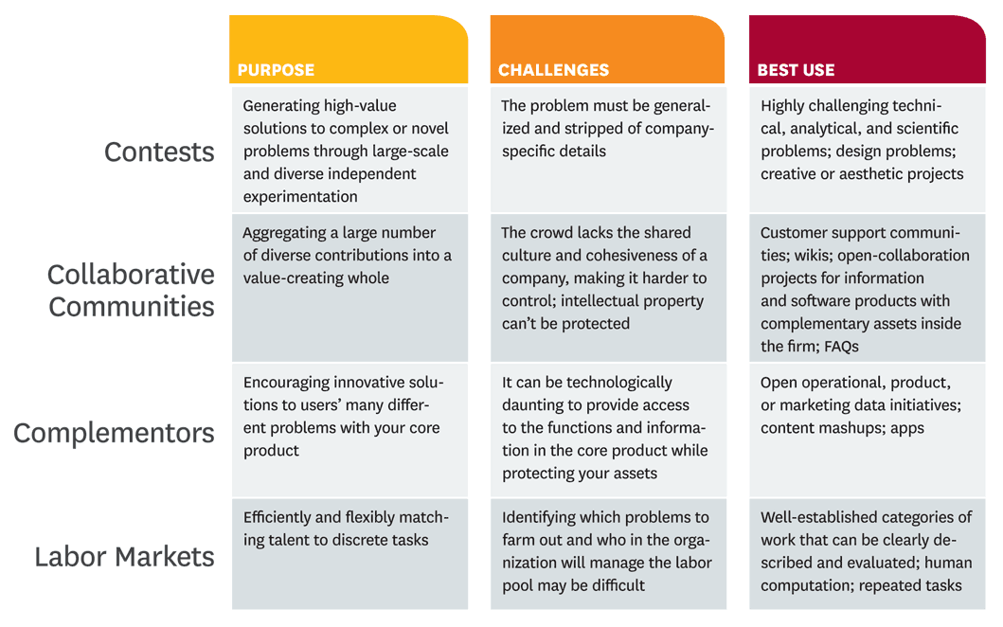
Concepts Surrounding Crowd Sourcing
Notes:
Boudreau and Lakhani - Harvard Business Review April, 2013

Slide 34

5. Technology Appropriation
Images Credit

Slide 35
5. Integration Of Technologies Into The Business
Capability of a firm to actually implement an innovative technology is the key element to its success:
Absorptive capacity
Technology transfer
‘Knowhow required to practically get a technology to work’
Skills and know-how is often not written down (RISK !)
Facility requirements
Business systems
Supply chain
Technology often out paces the skill of workers to implement it
Training
Key Human Resources decisions to be made
Safety – employees, consumers, general public
Notes:
Example of the relay race from Rieck and Dickson, Technology Analysis and Strategic Management, Vol 5 (4), 1993, 397p
Technology transfer is not easy – skills required, which are with the “people” who developed the technology.
These key staff members may not be “transferred” with the technology making it more difficult or risky to take advantage of the technology you have bought in.

Slide 36
Strategies To De-risk
Pilot runs, simulation / modelling
Beta testing (games)
Test the market prior, during and/or following the development of technologies
“Voice of Customer”
Could be internal customer as well as external
Beta testing (games)
Minimal viable product
Need to have written processes, staff shadowing, opportunity for ‘augmented reality’ techniques
Larger companies often ‘spin out a new company’ to try the idea thereby protecting the parent companies brand (see later)

Slide 37

6. Managing Implemented Technology

Slide 38
6. Getting The Most Out Of What We Have
Cannot maintain position via ad hoc implementation of technology
Culture of continuous improvement
Total quality management (e.g. six sigma, lean manufacturing, ISO9000)
Basic Principles:
Customer focused
Employee engagement
Process centred
Integrated systems
Strategic approach
Continual improvement
Fact based decision making
Communication
The Certified Manager of Quality/Organizational Excellence Handbook, Russell Westcott (Ed) pages 291-292.
Notes:
The Certified Manager of Quality/Organizational Excellence Handbook, pages 291-292.
Customer-focused. The customer ultimately determines the level of quality.
Total employee involvement. All employees participate in working toward common goals.
Process-centered. A fundamental part of TQM is a focus on process thinking. The steps required to carry out the process are defined, and performance measures are continuously monitored in order to detect unexpected variation.
Integrated system. Although an organization may consist of many different functional specialties often organized into vertically structured departments, it is the horizontal processes interconnecting these functions that are the focus of TQM.
Strategic and systematic approach. A critical part of the management of quality is the strategic and systematic approach to achieving an organization’s vision, mission, and goals. This process, called strategic planning or strategic management, includes the formulation of a strategic plan that integrates quality as a core component.
Continual improvement. A major thrust of TQM is continual process improvement. Continual improvement drives an organization to be both analytical and creative in finding ways to become more competitive and more effective at meeting stakeholder expectations.
Fact-based decision making. In order to know how well an organization is performing, data on performance measures are necessary.
Communications. During times of organizational change, as well as part of day-to-day operation, effective communications plays a large part in maintaining morale and in motivating employees at all levels. Communications involve strategies, method, and timeliness.

Slide 39
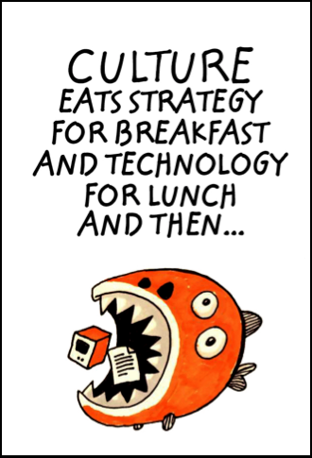
Final Words On Strategy……..
*Peter Drucker
http://www.strategyand.pwc.com/media/file/Katzenbach-Center_Webinar_Culture-Eats-Strategy-for-Breakfast.pdf

